Slide 1
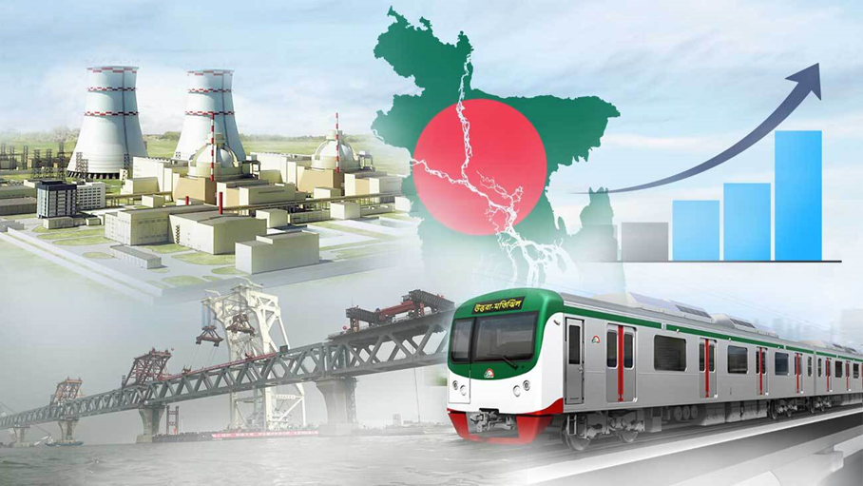
Impacts of Megaprojects to the Environment of Bangladesh
Presented By
Imtiaze Nur Ridoy
Dept. of Soil and Environmental Sciences
Year: M.S Session: 2021-22
Roll No: SES031

Slide 2
Background of Megaprojects
Bangladesh, a fast-growing economy, has embraced numerous megaprojects to address its infrastructure deficits and boost economic development.
Projects like the Padma Bridge, the Rooppur Nuclear Power Plant, and the Rampal Coal Power Plant are transforming the landscape of the country.
However, such large-scale developments often result in unintended consequences, particularly concerning the environment.
Understanding the impacts of these megaprojects on the environment is crucial for ensuring that economic growth does not come at an unsustainable cost to natural resources

Slide 3
Key Megaprojects in Bangladesh
Padma Bridge: A vital infrastructure project aimed at improving connectivity between the capital Dhaka and the southern regions of Bangladesh.
Rooppur Nuclear Power Plant: The country’s first nuclear power facility, expected to significantly boost electricity generation capacity.
Rampal Coal Power Plant: A coal-based power plant near the Sundarbans, raising concerns over its environmental implications.

Slide 4
Environmental Impacts of Megaprojects in Bangladesh
Deforestation and Loss of Biodiversity
The loss of biodiversity and forest cover is one of the main effects of megaprojects in Bangladesh.
Large swaths of land must frequently be cleared for the construction of roads, bridges, and power plants, which upsets the local ecology.
For instance, the Sundarbans, a UNESCO World Heritage site, are close to the Rampal Power Plant, which endangers the delicate mangrove forest environment.

Slide 5
Environmental Impacts of Megaprojects in Bangladesh
Air and Water Pollution
During the building and operating stages, megaprojects significantly pollute the air and water.
Significant amounts of carbon dioxide, sulfur dioxide, and nitrogen oxides are anticipated to be released by the Rampal Coal Power Plant, thereby deteriorating the quality of the air in the vicinity.
Furthermore, the plant's wastewater and coal ash discharge could contaminate neighboring waterways, harming both human health and marine life

Slide 6
Environmental Impacts of Megaprojects in Bangladesh
Impact on Water Resources
Many of Bangladesh’s megaprojects, such as the Padma Bridge, directly affect the country’s rivers and waterways.
The construction of bridges and dams can disrupt natural water flow, leading to changes in sedimentation patterns, erosion, and increased flood risks.
The Padma Bridge project has altered sediment dynamics in the Padma River, with potential long-term impacts on aquatic ecosystems.

Slide 7
Environmental Impacts of Megaprojects in Bangladesh
Soil Degradation
Megaprojects also contribute to soil degradation through activities such as excavation, land reclamation, and construction.
Large-scale infrastructure projects like highways and power plants disturb the soil structure, leading to erosion, reduced fertility, and contamination.
For instance, land use changes associated with the Rooppur Nuclear Power Plant have led to soil degradation in surrounding areas.

Slide 8
Environmental Impacts of Megaprojects in Bangladesh
Climate Change Implications
The energy-intensive nature of megaprojects, particularly those involving fossil fuels, contributes to greenhouse gas emissions and exacerbates the impacts of climate change.
Coal-based power plants like Rampal are major sources of carbon emissions, which not only affect local air quality but also contribute to global warming.
Bangladesh, being one of the most vulnerable countries to climate change, faces significant risks from such projects.

Slide 9
Major Findings from the Megaprojects
Padma Bridge – Impacts river flow and aquatic ecosystems
Rampal Coal Power Plant – Poses risks to the Sundarbans mangrove forest
Rooppur Nuclear Power Plant – Raises concerns over nuclear waste disposal and water use

Slide 10
Policy Frameworks and Environmental Management
The Environmental Impact Assessment (EIA) process is a mandatory requirement for large projects. However, enforcement of these regulations remains weak, often leading to environmental degradation
While EIAs are a crucial tool for assessing the environmental impacts of megaprojects, their effectiveness in Bangladesh is often undermined by insufficient baseline data, limited public participation, and weak enforcement mechanisms.
Despite the existence of environmental regulations, gaps in governance and institutional capacity hinder the effective management of megaprojects' environmental impacts. Corruption, lack of coordination among government agencies, and political pressure often lead to environmental oversight being compromised.

Slide 11
Key Recommendations for Sustainable Development
Strengthen environmental policies and regulatory enforcement.
Prioritize green technologies in project planning.
Increase community involvement in decision-making.
Establish independent monitoring to ensure compliance and accountability.

Slide 12
Thank you

